Slide 1
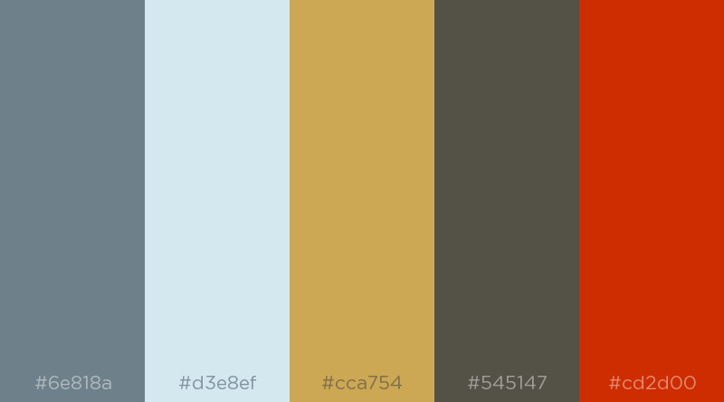
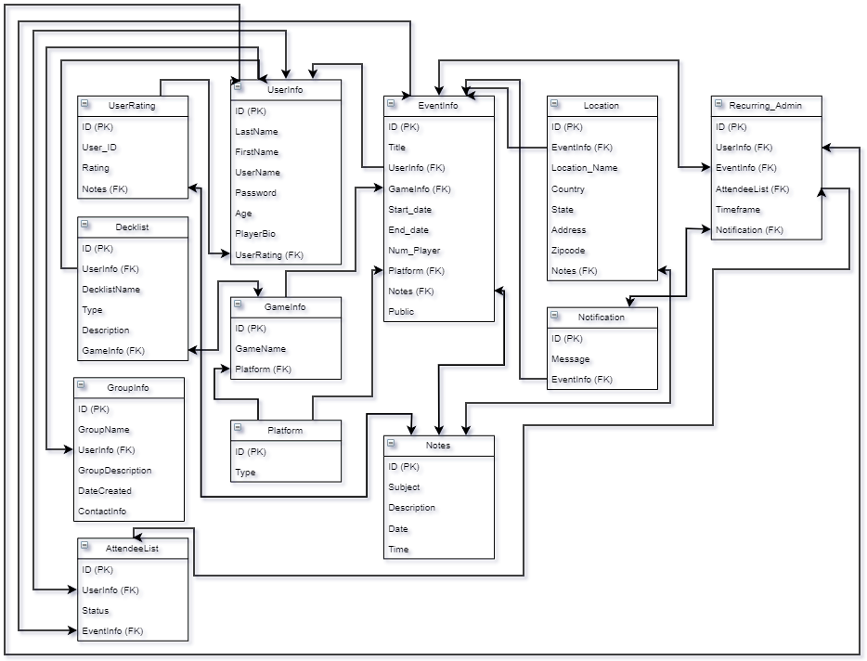
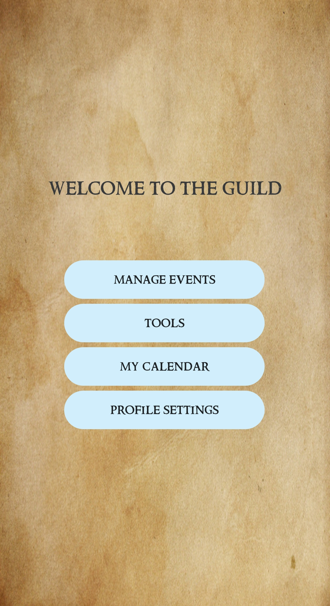
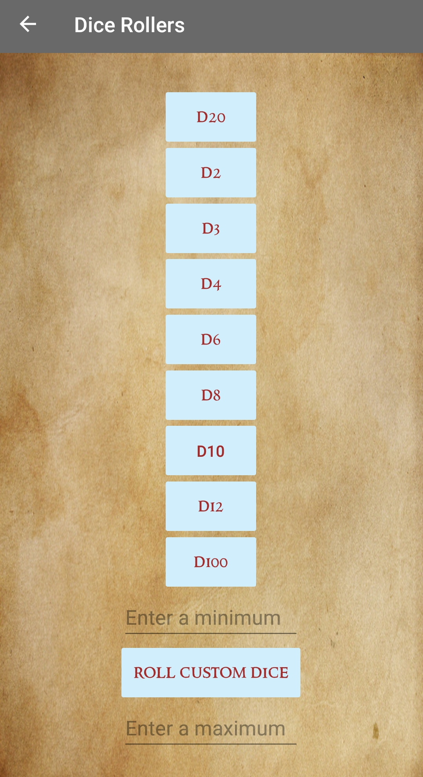
Guild
Team Members: Blake Cash, Riley Moore, Ryan Van
Advisors: Chase Carthen (UNR), Mitchell Martinez (IGT)
Instructors: Sergiu Dascalu, Devrin Lee
CS 426 Senior Project – Spring 2019 Departments of Computer Science and Engineering
CSE
Abstract
User Interface
Architecture
Guild is an event planning app for iOS and Android devices with a strict focus on tabletop gaming, collectible card games, and LAN gaming. In addition to a traditional event planning interface, Guild provides a large generalized tool set to users and event organizers, helping to facilitate every step of organizing an event, from initial planning to actually running the event. In this way, Guild intends to be considered a ‘go-to’ application as far as creating easy to organize and effectively run events that are enjoyable for both attendants and organizers.
The Guild team put a good deal of effort into ironing out the specifics of it’s user interface design. On the presentation front, Guild is meant to feel like the user is reading a scroll, keeping with the fantasy theme of many of the games it caters towards. This is done through a color palette seen in Figure 1, In terms of interface flow, Guild is split into two parts, visible on Figure 3, with one half of the app dedicated toward a traditional event planning interface and the other half dedicated to game-specific tools.
Guild was built using Xamarin, using Xamarin Forms for the User Interface, and a MySQL Database to store all the essential information. Flask, a micro web framework, allows for the front end and back end of Guild to communicate through use of JSON. The MySQL Database and Flask are being hosted using Amazon Web Services, where Flask is running on an Ubuntu Virtual Machine. Figure 5 details the schema of Guild’s SQL Database.
Goals
The goal of Guild is to create an app that allows gamers to spend less time planning, and more time playing the games they love. By allowing gamers the ability to plan events specific to their demographic and run them more easily, Guild will help facilitate all manner of in-person gaming events. It is the desire of the Guild team to provide the tools required to allow local gaming scenes to thrive.
Figure 1: Guild’s UI color scheme
Figure 2: Guild’s Logo
Future Work
Figure 5: Database schema of Guild’s database
Future development would entail expansion of the toolkits associated with Guild. The team wants to add more niche tools like character sheet saving for Dungeons and Dragons, card information for card games, and expansion of bracket formats for LAN gaming, as well as tie the bracket feature into the events system further. In addition, Guild’s developers would like to create a website that offers much the same functionality as the mobile application.
Conclusion
The team members of Guild came to the conclusion that the local gaming niche was lacking any application that catered towards it’s specific needs. Guild fulfills these needs by offering a useful general event planning interface along with specialized tools unique to in-person gaming events, and the team believes that Guild has the potential to foster growth in local gaming scenes across the country.
Figure 3: Guild’s main menu
Figure 4: One of Guild’s tools, the dice roller
This project was developed in Spring 2019 as part of the course CS 426 Senior Projects in Computer Science

